Slide 1
Introduction to Machine learning
Second Project
Louis Urbin
Dániel Galacz

Slide 2
Introduction
Based on the Beijing PM2.5 dataset
Air quality and meteorological measurements
Particulate matter with diameter less than 2.5 micrometers
2010-2014
2 objectives:
Classification
Forecasting
4 levels based on EPA thresholds
EPA category | μg/m³ of PM2.5 | Our category
Good | 0.0 to 9.0 | Good
Moderate | 9.1 to 35.4 | Moderate
Unhealthy for sensitive groups | 35.5 to 55.4 | Unhealthy
Unhealthy | 55.5 to 125.4
Very unhealthy | 125.5 to 225.4
Hazardous | 225.5+ | Hazardous

Slide 3
Data exploration and preparation

Slide 4
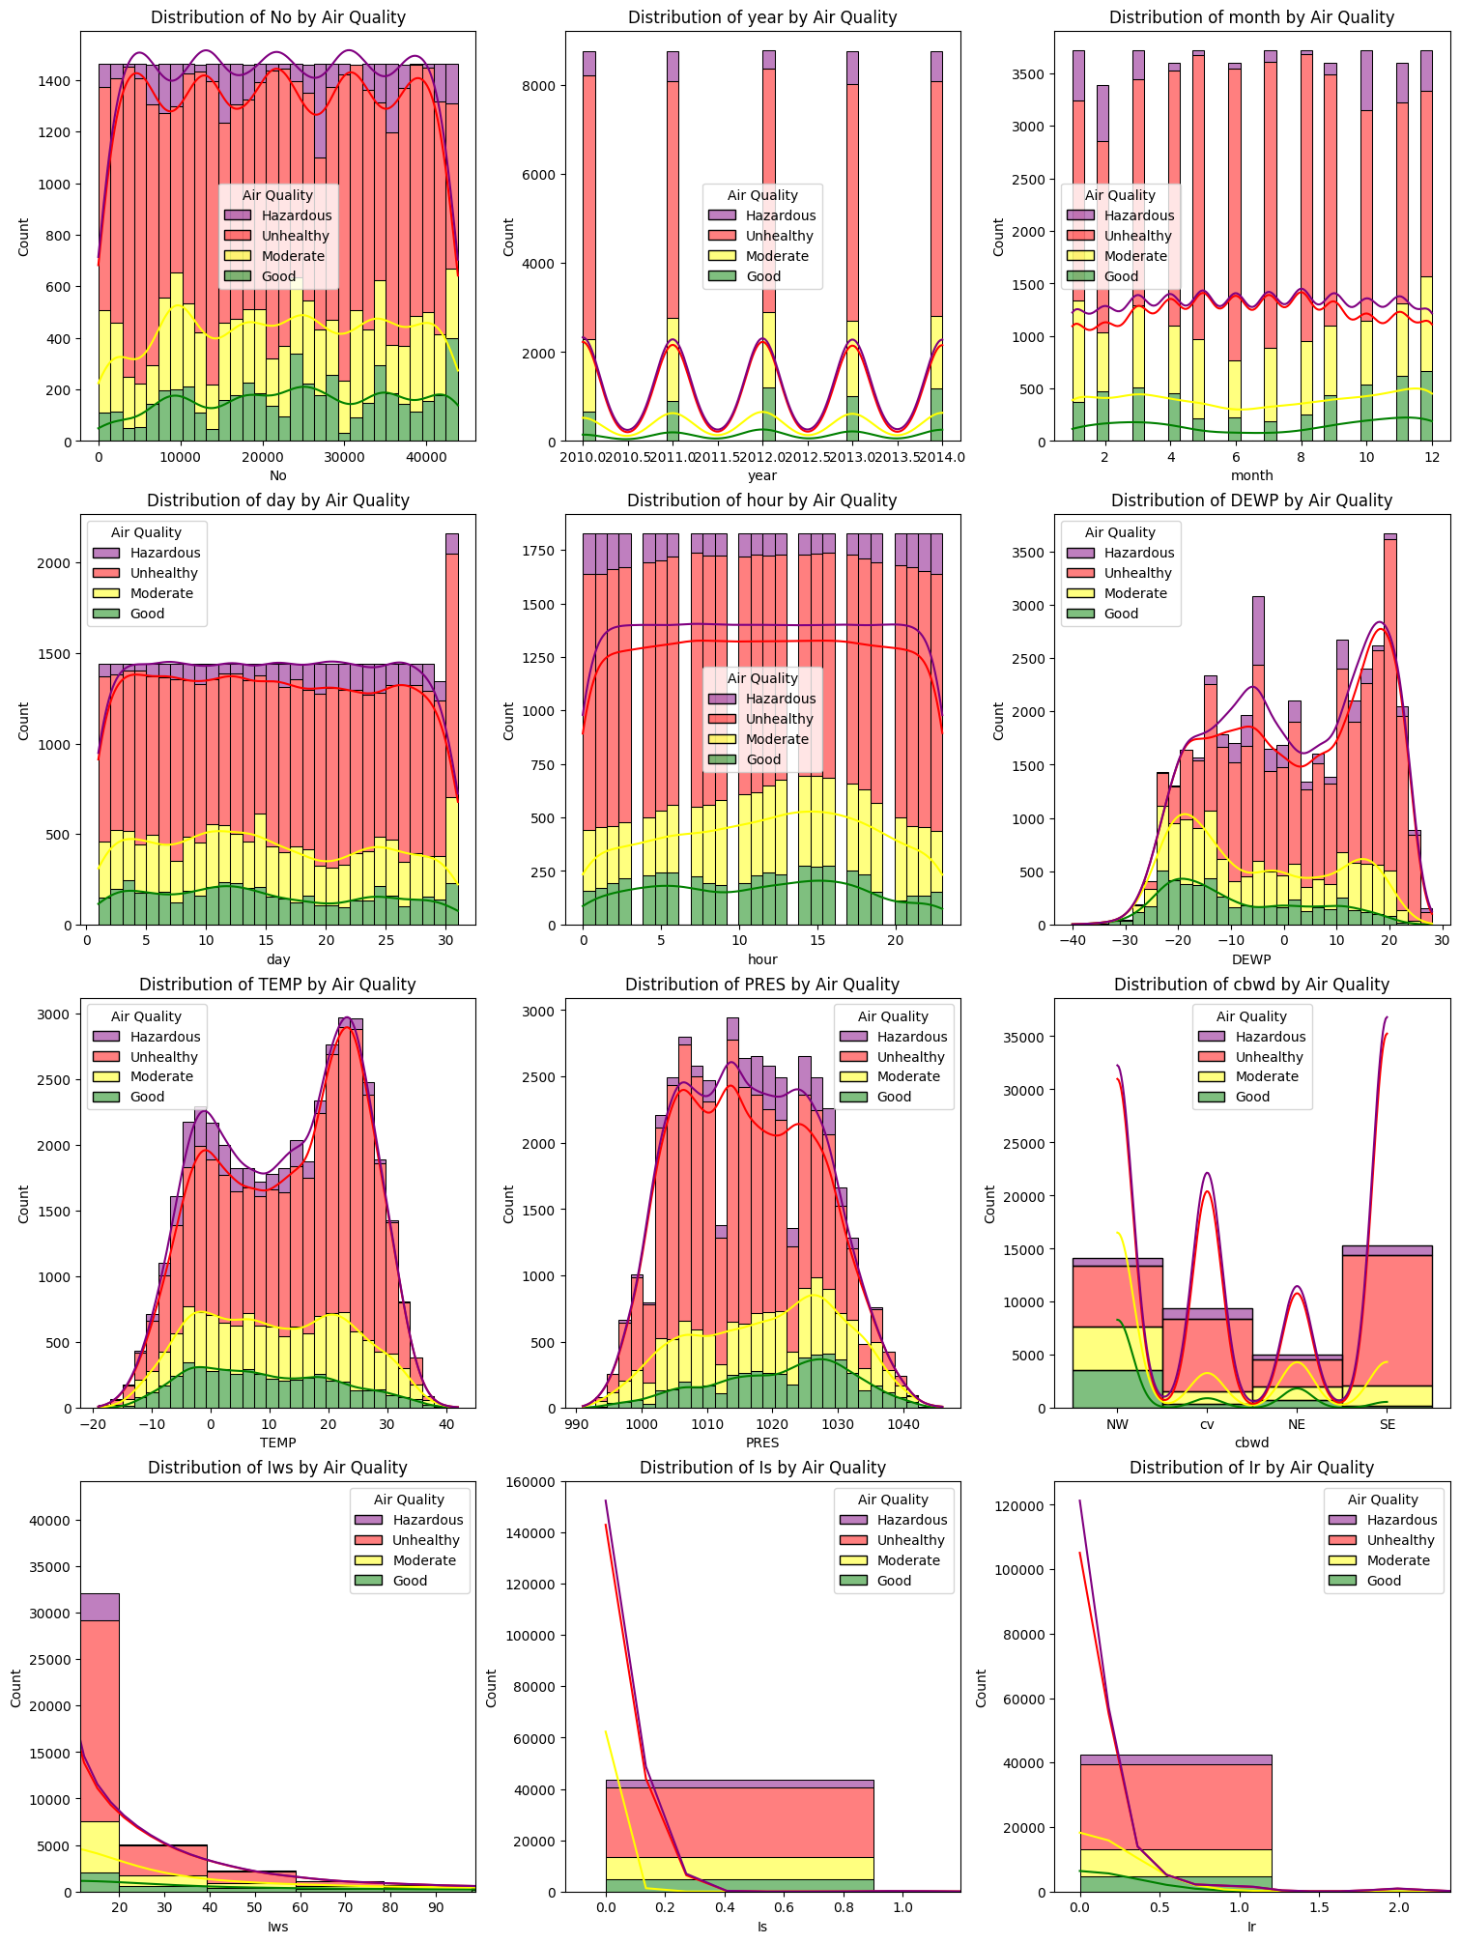
Data understanding
43824 hourly observations from 2010 to 2014 in Beijing
PM2.5 had missing values
We used the median
We created an Air Quality variable, based on PM2.5 thresholds
We plotted the distribution of key features grouped by air quality levels

Slide 5
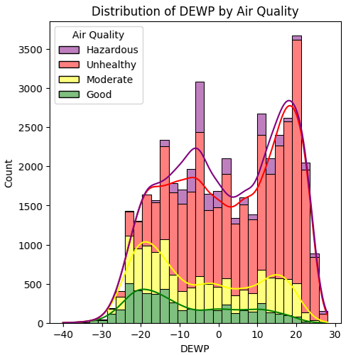
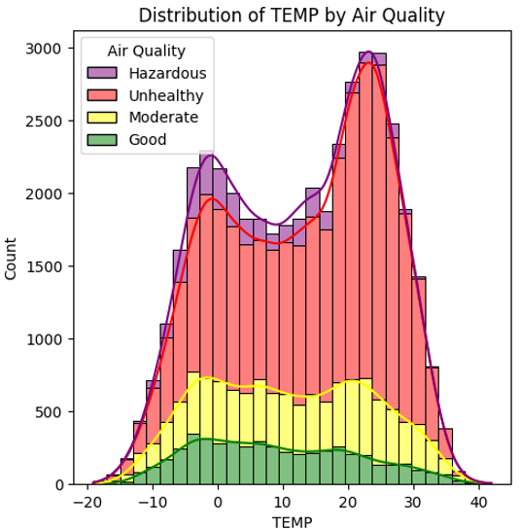
Dewpoint and tempereature

Slide 6
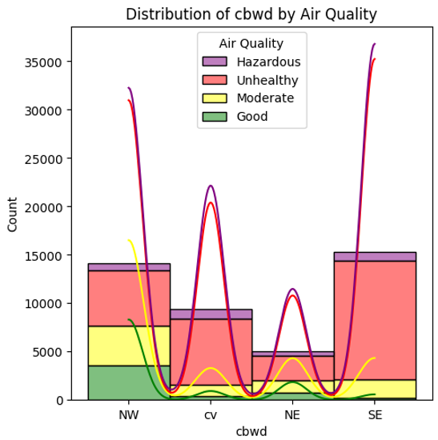
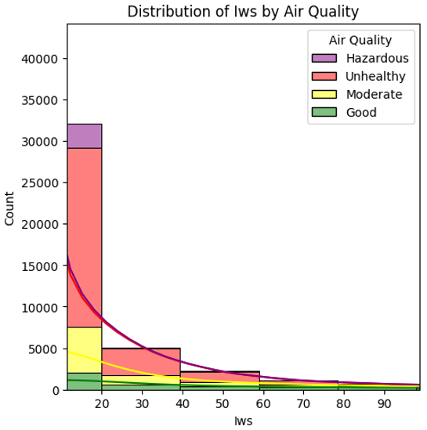
Wind direction and wind speed

Slide 7
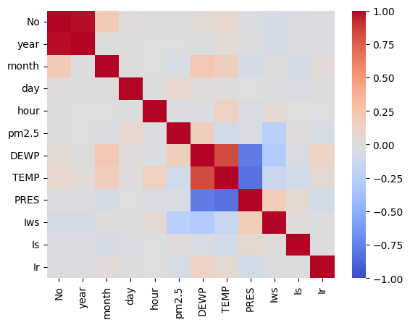
Correlation
Correlation between Number and Year
Both represent temporal order
Correlation between Temperature, Pressure and Dewpoint
Because of physical laws

Slide 8
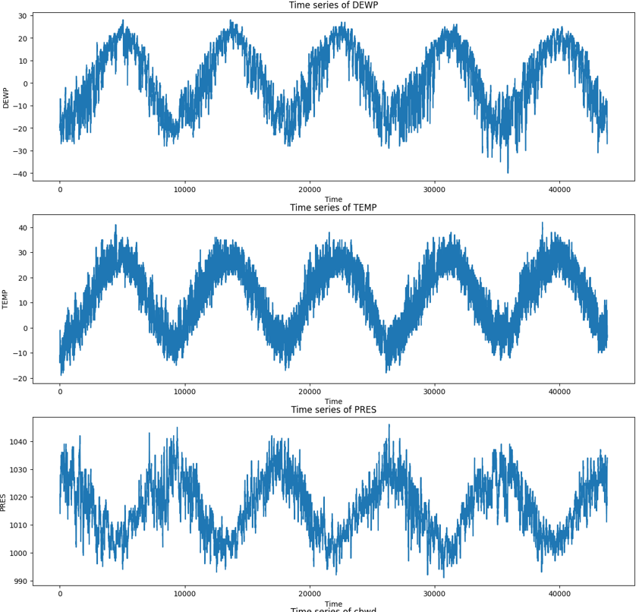
Investigation of temporal patterns
Dewpoint and Temperature are lower during winter, while Pressure is higher
PRES TEMP DEWP

Slide 9
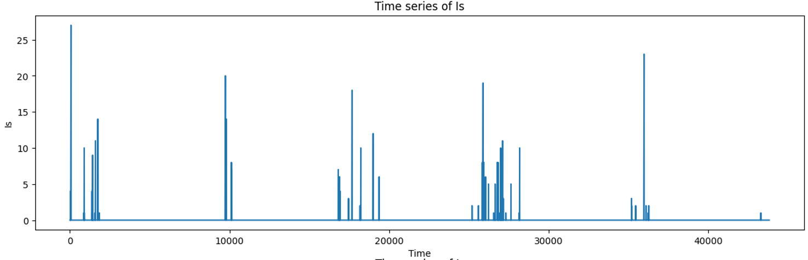
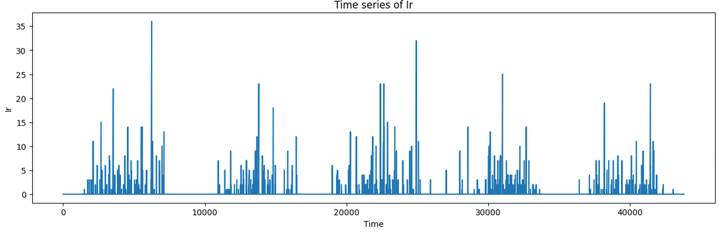
Investigation of temporal patterns
Most of the rainy days are in the monsoon season between May and September
Snowfalls mostly happen during winter
RAIN SNOW

Slide 10
Classification

Slide 11
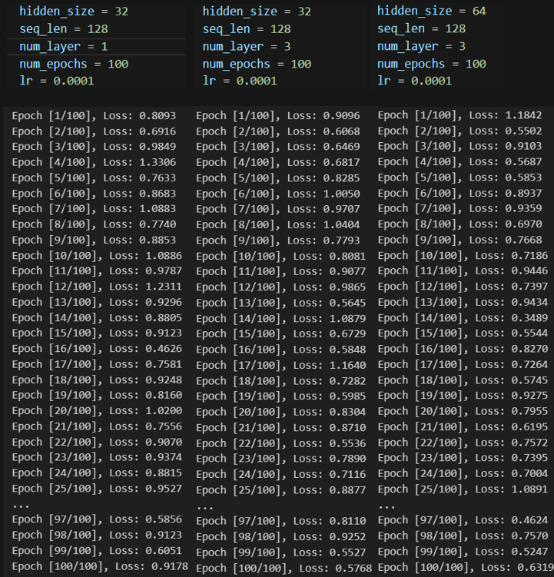
Vanilla Recurrent Neural Network (VRNN)
We experienced with several hyperparameter
Eventually the training proved unstable
We explored alternative models

Slide 12
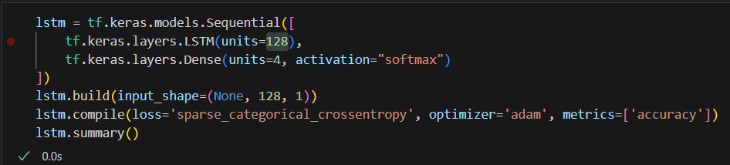
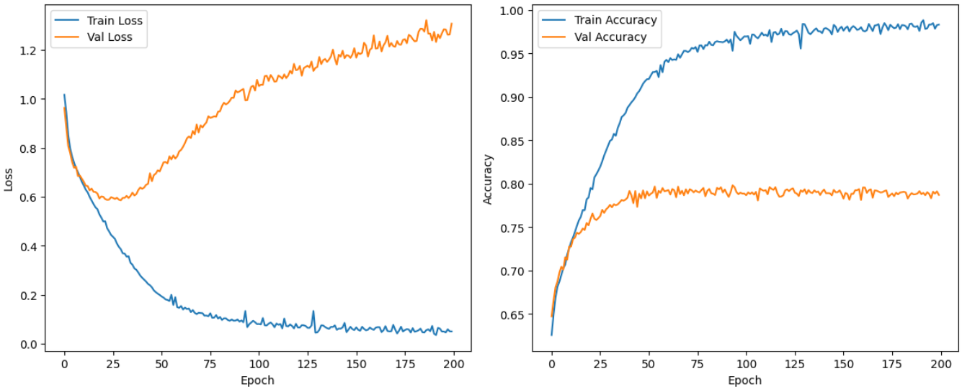
Long Short-Term Memory (LSTM)
We tested several architectures
Different number of units in the LSTM layer
Different sequence lengths
Batch sizes
Dropout rates
Significantly better stability

Slide 13
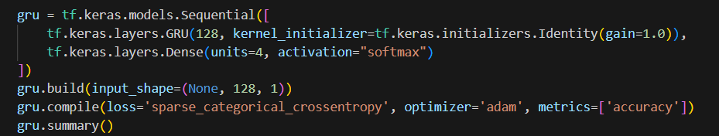
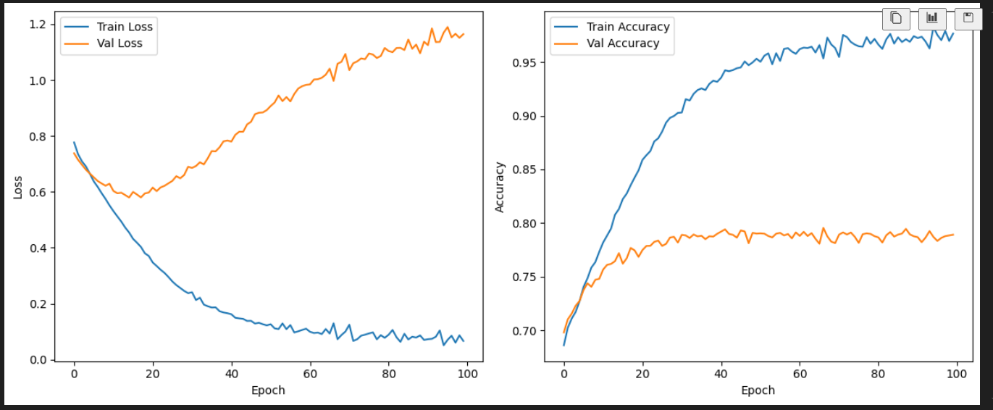
Gated Recurrent Unit (GRU)
Did not improve performance
Slower overfitting
Simpler model

Slide 14
Forecasting

Slide 15
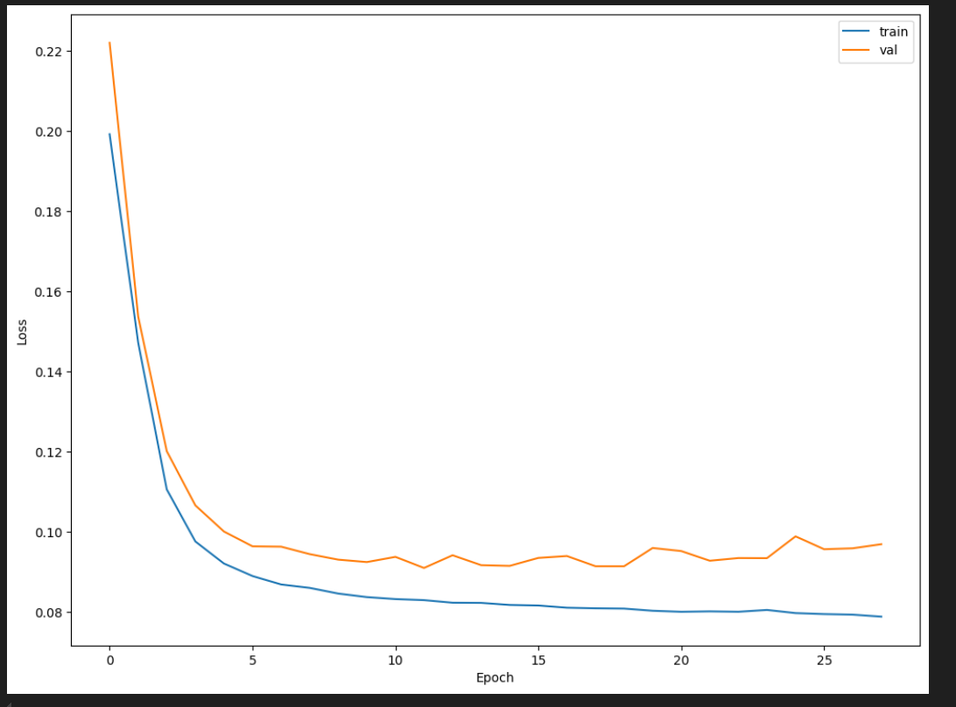
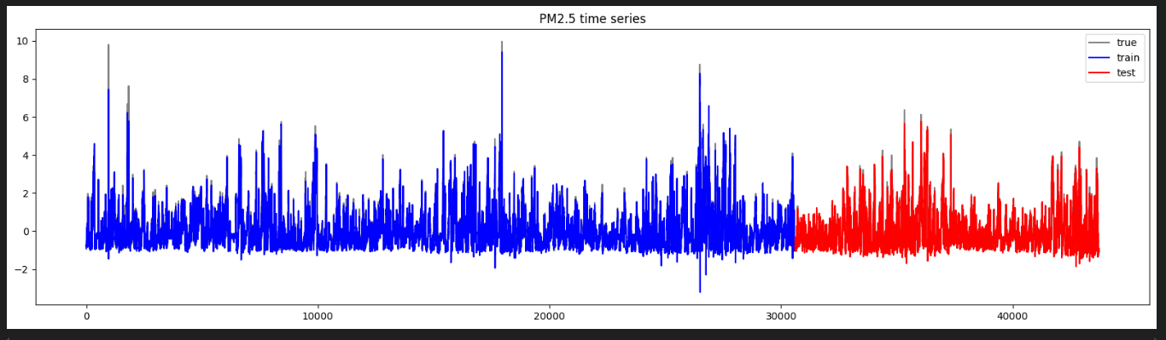
LSTM
We tried 1, 2 and 3-layered networks
The best model:
Single LSTM layer
64 neurons
Window size of 100

Slide 16
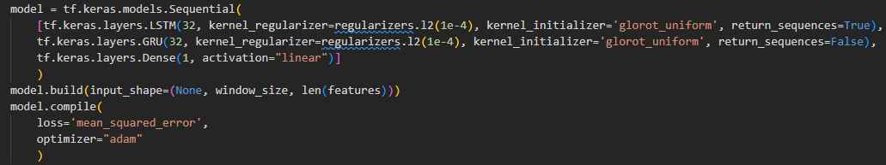
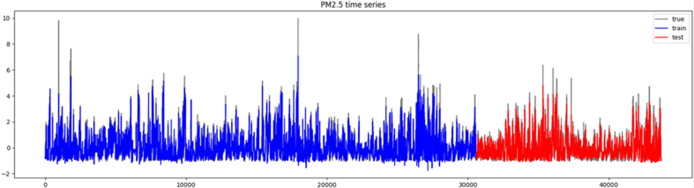
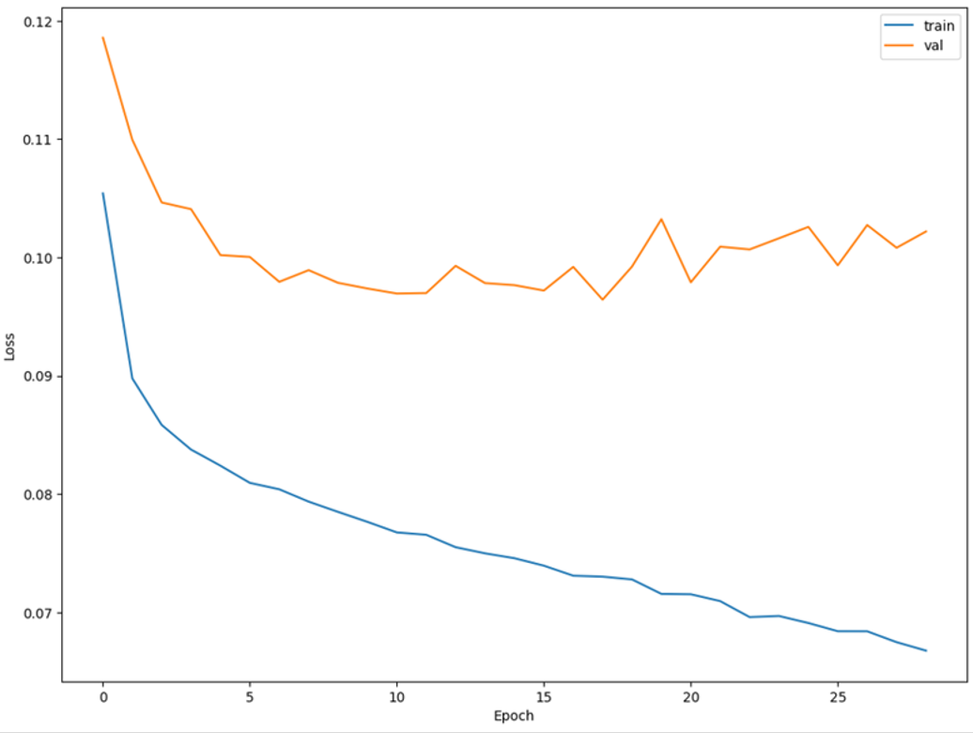
encoder-decoder RNN
L2 regularization
Glorot uniform initializer
Effective for sigmoid activations in recurrent layers
Faster convergence
Less accurate for extreme pollution events

